Slide 1
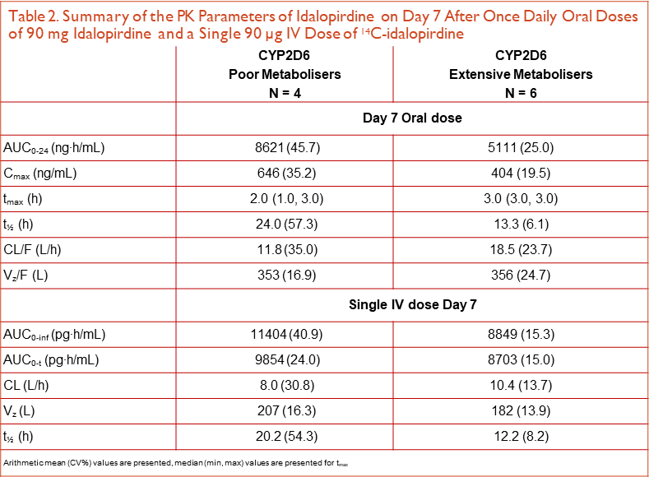
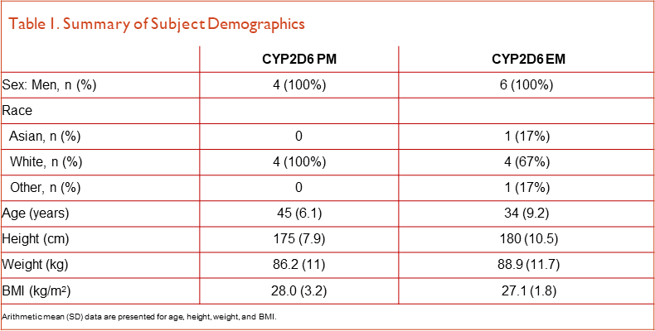
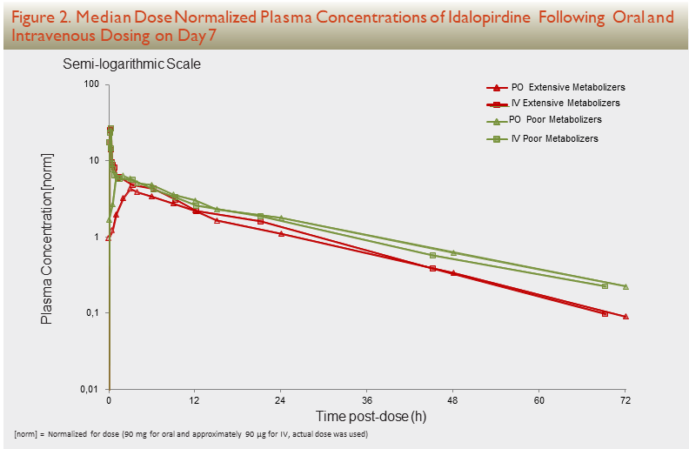
Assessment of the Contribution of CYP2D6 to the Elimination of Idalopirdine as well as the Absolute Bioavailability Following Multiple Oral Dosing
E. Schmidt¹, J. Areberg¹, P. Evans², V. Zann², B. Søgaard¹ ⁻
¹ H. Lundbeck A/S, Valby, Denmark, ² Quotient Clinical, Nottingham, UK
INTRODUCTION
RESULTS
CONCLUSIONS
PURPOSE
RESULTS
Rationale and Scope of Study: Contribution of CYP2D6 to the Elimination of Idalopirdine
Idalopirdine is a 5-HT6 antagonist in development as adjunct therapy to acetylcholinesterase inhibitors for mild-to-moderate Alzheimer’s disease. Idalopirdine is almost exclusively cleared by biotransformation and based on in vitro data, CYP2D6 appears to be the main route of metabolization with some contribution from other CYPs including CYP3A4/5.
This study assessed the contribution of CYP2D6 to the metabolization of idalopirdine by comparing pharmacokinetics in CYP2D6 extensive metabolizers (EM) and poor metabolizers (PM) following multiple oral dosing. Comparison of pharmacokinetic (PK) parameters in PMs and EMs may substitute for an interaction study of the effect of CYP2D6 inhibition. [1]
Subject demographics: Subject demographics are summarized by metabolizer status in Table 1, all subjects were men aged between 23 and 52 years, with a BMI between 23.7 and 31.3 kg/m2.
The results from this study confirm the contribution of CYP2D6 to the metabolization of idalopirdine; however the effect was modest with less than a doubling in exposure in CYP2D6 PMs compared to EMs.
The likelihood of significant drug-drug interactions with idalopirdine and CYP2D6 inhibitors is low.
Absolute bioavailability of the idalopirdine immediate release tablet was approximately 60%.
The tested oral and intravenous doses of idalopirdine were safe and well tolerated.
Absolute Bioavailability: The absolute bioavailability (F) of an oral formulation provides information about absorption and first-pass metabolism of the drug and can help explain variability and/or support development of additional formulations. F is determined as the ratio of the exposure (AUC) following dosing of the oral formulation to direct intravenous dosing.
In this study, F was determined by semi-simultaneous administrations of an oral therapeutic dose of idalopirdine and a single intravenous micro-dose of ¹⁴C-labelled idalopirdine. PK blood samples were analyzed by traditional LC-MS/MS (oral dose) and accelerated mass spectrometry (AMS) (intravenous dose), respectively. Compared to the traditional crossover design, this approach has the advantages of no requirement for systemic IV toxicity testing to cover the human intravenous
(IV) dosing as the IV dose is a micro-dose, [2] and due to the low dose given by the IV route the formulation development of the IV drug product is often less challenging than that of a therapeutic IV dose. There remains the question of whether pharmacokinetic data from a microdose study will be predictive of the pharmacokinetics at a higher, therapeutic, dose but this is not considered an issue in this design, as the oral and IV PK are determined at the same time. [2]
METHODS
Idalopirdine PK
Following oral dosing, the median tmax was 3 hours (range 1-3 hours) as anticipated. (Table 2). Steady state, as determined by visual inspection of the pre-dose plasma concentrations (Cpre), was achieved after 7 days of dosing (data not shown). Mean t½ was longer in the PM group, 24.0 hours, compared to 13.3 hours in the EM group and mean CL/F was 11.8 L/h in the PM group and 18.5 L/h in the EM group, respectively.
A similar pattern was observed following intravenous dosing; mean CL was 8.0 L/h in the PM group and 10.4 L/h in the EM group, respectively. Also mean t½ was longer in the PM group than in the EM group, and for each group was similar to that observed after oral doses of idalopirdine (Figure 2).
Contribution of CYP2D6 to the Elimination of Idalopirdine
Following 7 days of idalopirdine dosing the exposure in terms of AUC0-24 and Cmax was 62% and 55% higher, respectively, in CYP2D6 PMs compared to EMs (Table 3), confirming the contribution of CYP2D6 to the metabolization of idalopirdine.
REFERENCES
METHODS
FDA: Draft Guideline on Drug Interaction Studies – Study Design, Data Analysis, Implications for Dosing, and Labeling Recommendations, CDER February 2012.
Lappin G and Stevens L, Biomedical accelerator mass spectrometry: recent applications in metabolism and pharmacokinetics. Expert Opin Drug Metab Toxicol (2008) 4(8):1021-1033.
World Medical Association (WMA). Declaration of Helsinki: Ethical principles for medical research involving human subjects. http://www.wma.net/e/
Acknowledgement: This study was sponsored by Otsuka Pharmaceutical Co, Ltd. and H. Lundbeck A/S
The authors would like to acknowledge Quotient Clinical for performing the clinical study
Clinical Study: This open-label study was conducted in 10 healthy male subjects, determined at screening to be CYP2D6 EMs (N=6) or PMs (N=4). The study was designed and conducted in accordance with the principles of the Declaration of Helsinki, [3] and initiated after approval by Ethics Committee and regulatory authorities (MHRA). All enrolled subjects provided written informed consent. Subjects received 90 mg idalopirdine tablets (PO) once daily for 7 days. With the final dose, the subjects received a single IV micro-dose infusion of 14C-idalopirdine 90 μg (notdose). Blood samples for full PK profiles were collected up to 72 and 144 hours post-dose IV and PO, respectively. See Figure 1. Safety and tolerability was assessed throughout the study period.
Bioanalysis for PO Dose: Idalopirdine was determined in human plasma using Ultra-Performance LC® chromatography followed by tandem-MS detection. A stable-isotope analogue of idalopirdine was used as internal standard. Protein precipitation was used as sample cleanup. Human EDTA-plasma was used to prepare calibration standards, quality control samples, blank samples and for sample dilution.
Bioanalysis for PO Dose
Idalopirdine was determined in human plasma using Ultra-Performance LC® chromatography followed by tandem-MS detection. A stable-isotope analogue of idalopirdine was used as internal standard. Protein precipitation was used as sample cleanup. Human EDTA-plasma was used to prepare calibration standards, quality control samples, blank samples and for sample dilution.
AMS Analysis for IV Dose: 14C-idalopirdine was determined in human plasma using HPLC fractionation followed by AMS. Plasma samples, calibration standards, quality controls and blanks were prepared by protein precipitation. 14C-idalopirdine was isolated using HPLC fractionation and fractions were submitted to graphitization through combustion of samples. Through a series of steps the produced CO2 gasses were captured on the surface of iron powder that was subsequently pressed into individual cathodes and submitted for AMS analysis.
Contribution of CYP2D6 to the Elimination of Idalopirdine
Following 7 days of idalopirdine dosing the exposure in terms of AUC0-24 and Cmax was 62% and 55% higher, respectively, in CYP2D6 PMs compared to EMs (Table 3), confirming the contribution of CYP2D6 to the metabolization of idalopirdine.
(AUC /90 mg)/(AUC /90*10-3 mg) was 57.8% and 69.0% in CYP2D6 EMs and PMs, 0-24 PO 0-inf IV
respectively. (Table 4)
CONCLUSIONS
PK Analysis: All PK estimations and plot drawings were performed with the software S-PLUS®. The PK time profile), CL (clearance), t½ (elimination half-life), and absolute bioavailability (F) were determined by standard non-compartmental analysis. The absolute bioavailability was determined from F = (AUC0-24 PO/90 mg)/(AUC0-inf IV/90*10 mg).
Poster presented at the ASCPT 2016 Annual Meeting, San Diego, CA, US, March 8-12, 2016
+44 (0)115 974 9000 (UK) +1-800-769-3518 (USA) info@quotientsciences.com www.quotientsciences.com

